Slide 1

Namespaces
By Min Thet Naing

Slide 2
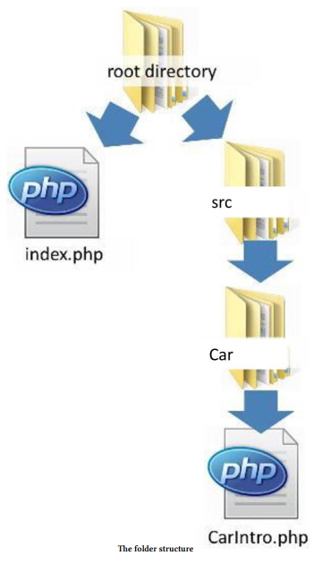
By Min Thet Naing

Slide 3
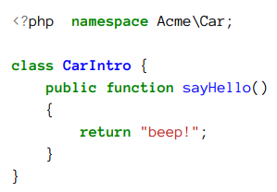
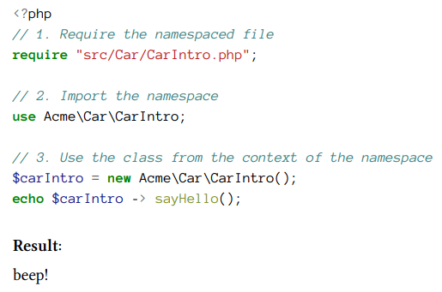
By Min Thet Naing

Slide 4
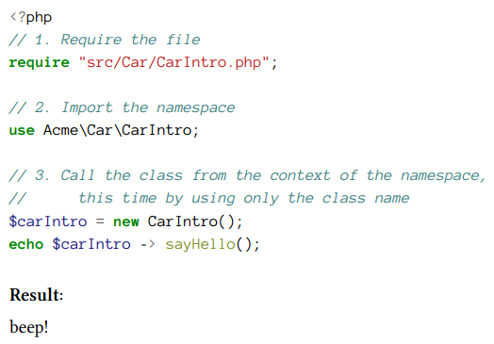
By Min Thet Naing

Slide 5
Alias a Class from a namespace with a friendly name
By Min Thet Naing

Slide 6
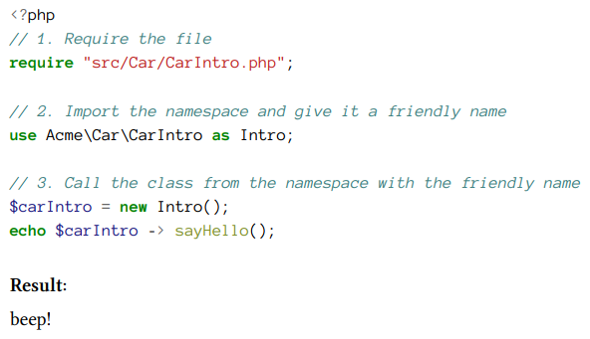
By Min Thet Naing

Slide 7
Call a Class from the global namespace
By Min Thet Naing

Slide 8
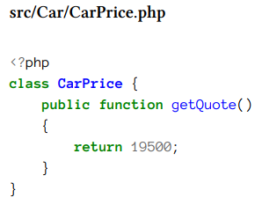
By Min Thet Naing

Slide 9
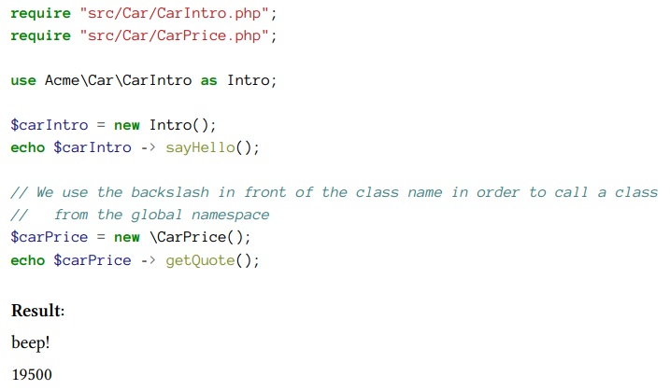
By Min Thet Naing

Slide 10
Can more than one namespace be imported into the same file?
By Min Thet Naing

Slide 11
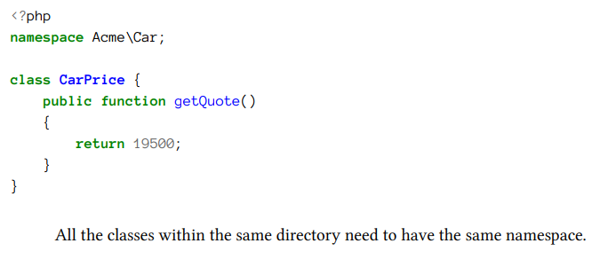
By Min Thet Naing

Slide 12
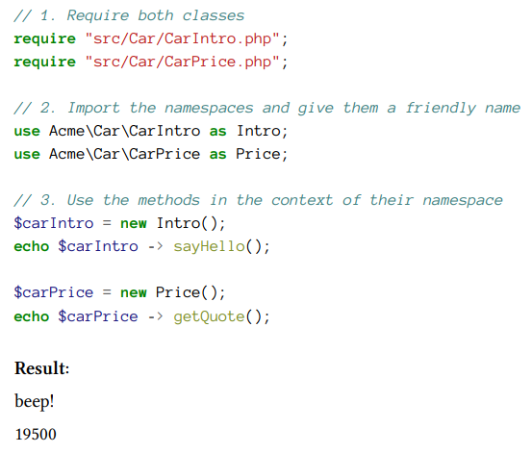
By Min Thet Naing

Slide 13
Group use declarations in PHP7
By Min Thet Naing

Slide 14
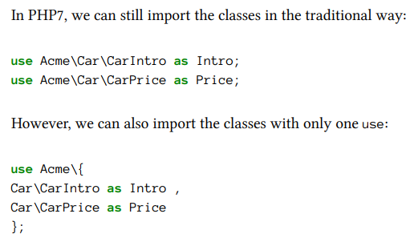
By Min Thet Naing

Slide 15
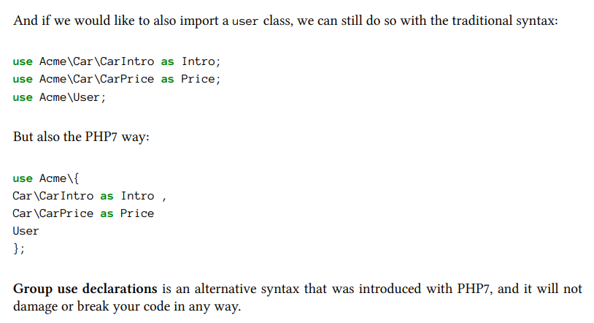
By Min Thet Naing

